Slide 1
OWASP Delaware: 2025-06 Meeting
david.rhoades@owasp.org
31-Mar-2026

Slide 2
Agenda
OWASP: Who? What? Why?
DE Chapter: Where? When? How? HELP!
Main Event:
Why APIs Are Every Attacker’s Favorite Target - by Dan Barahona
Notes:
Delete this slide if you don’t like Agenda slides, otherwise, just the highlights.

Slide 3
Open Worldwide Application Security Project (OWASP)
The Open Worldwide Application Security Project (OWASP) is a nonprofit foundation that works to improve the security of software.
All of the OWASP tools, documents, forums, and chapters are free and open to anyone interested in improving application security.
The OWASP Foundation is a not-for-profit entity that ensures the project's long-term success.
www.owasp.org

Slide 4


OWASP Delaware Chapter
All the chapter links: https://linktr.ee/owasp_delaware
Meetup, X, Discord, www, LinkedIn

Slide 5
OWASP Delaware Chapter Leads
Chapter leads:
david.rhoades@owasp.org
Retiring chapter leads:
gionne.cannister@owasp.org
eric.truitte@owasp.org
David & Gionne work at Palindrome Technologies (www.PalindromeTech.com)
New/Pending chapter lead:
JackCornell#3793 aka “Chuck”
A now a moment to remember our district’s fallen heroes…

Slide 6
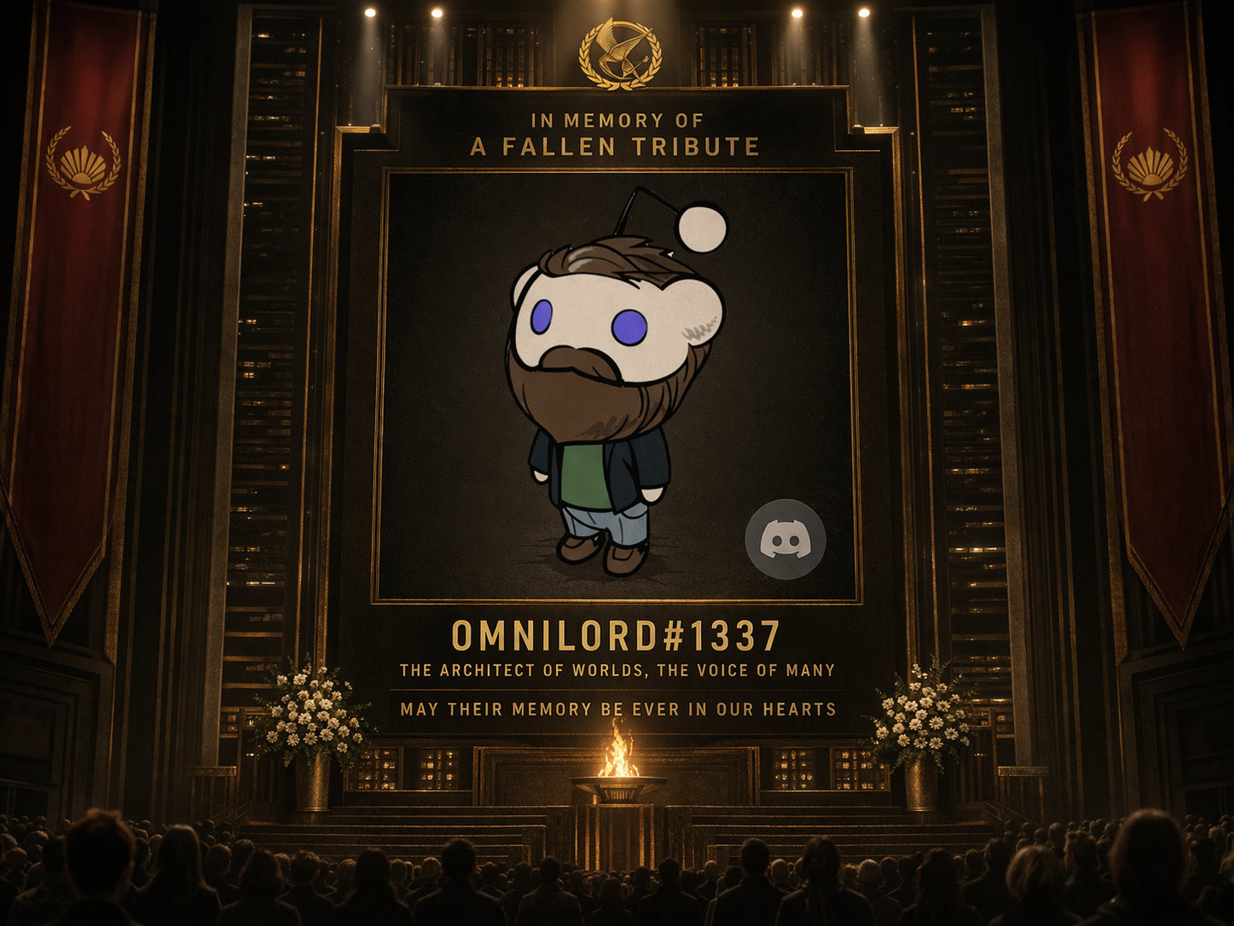
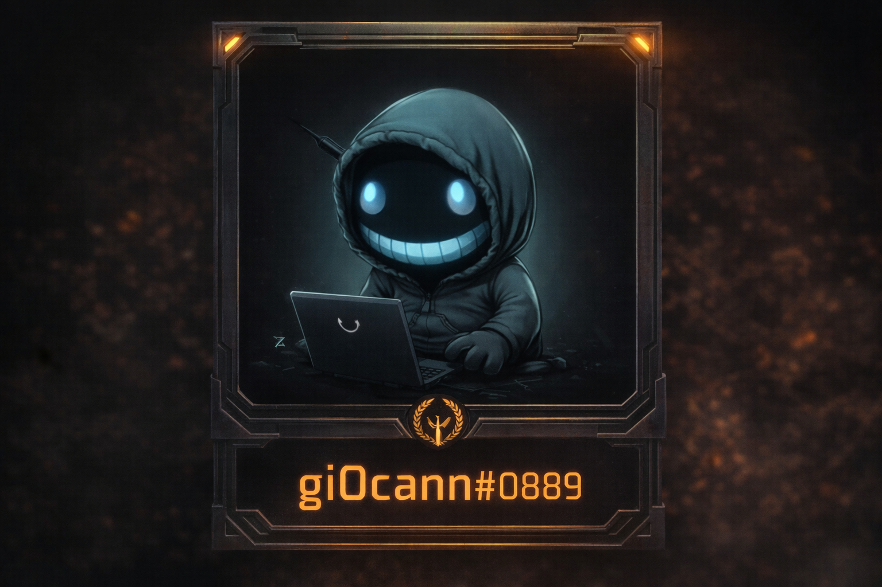
Our District’s Fallen Tributes

Slide 7
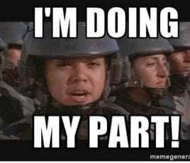
Delaware Chapter needs you.
Leadership – Do your part!
Would you like to know more?
Need social media mavens
Facebook, Twitter, Archie, Gopher…all dat
Mention us @owaspde on Twitter
Speakers!
Flash talks; quick demos; anything cyber’ish

Slide 8
Main Event
Why APIs Are Every Attacker’s Favorite Target - by Dan Barahona

Slide 9
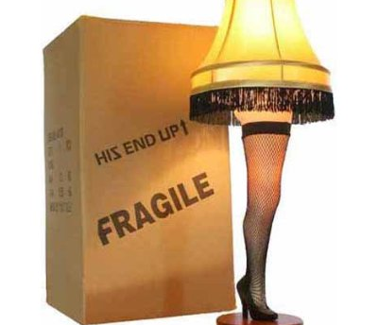
A gift for our guest speaker
It’s a major award!
This Photo by Unknown Author is licensed under CC BY-NC-ND

Slide 10
Time for mini-CTF?
Let’s hack some AI

Slide 11
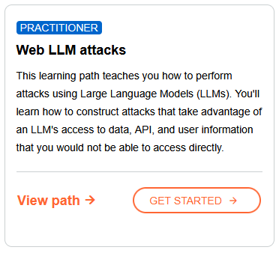
Portswigger’s Web Academy
Target: Web Academy – Learning Path: Web LLM attacks
https://portswigger.net/web-security/learning-paths/llm-attacks
Notes:
Please choose an upcoming AppSec Global, and any local regional or chapter events

Slide 12
Stay in the know
Chapter lead:
david.rhoades@owasp.org
More to come soon
Notes:
Place the logo and their support level in this slide. It should be the only place in which it appears in a presentation

Slide 13
Stay in the know
Chapter lead:
david.rhoades@owasp.org
All the chapter links: https://linktr.ee/owasp_delaware
X and Discord are best.
Soon Meetup will be back up and running.
LinkedIn!!!
It’s where all the cool kids hang. ☺

